Slide 1
ARIES
Session 48
© 2016 KL University – The contents of this presentation are an intellectual and copyrighted property of KL University. ALL RIGHTS RESERVED

Slide 2
Aries
    Aries- Algorithms for Recovery and Isolation Exploiting Semantics
    ARIES is a recovery algorithm designed to work with a no-force, steal database approach
    It is based on WAL (Write Ahead Logging)
    Repeating history during redo
    Logging changes during undo
© 2016 KL University – The contents of this presentation are an intellectual and copyrighted property of KL University. ALL RIGHTS RESERVED

Slide 3
Aries
    The ARIES recovery algorithm consists of three steps
  Analysis- The set of transactions that committed after the last checkpoint is determined
  Redo- necessary redo operations are applied
  Undo- transactions active at the time of crash are undone in reverse order
© 2016 KL University – The contents of this presentation are an intellectual and copyrighted property of KL University. ALL RIGHTS RESERVED

Slide 4
The Log and Log Sequence Number (LSN)
A log record is written for
      Data update (Write)
      Transaction commit
      Transaction abort
      Undo
      Transaction end
A unique LSN is associated with every log record
© 2016 KL University – The contents of this presentation are an intellectual and copyrighted property of KL University. ALL RIGHTS RESERVED

Slide 5
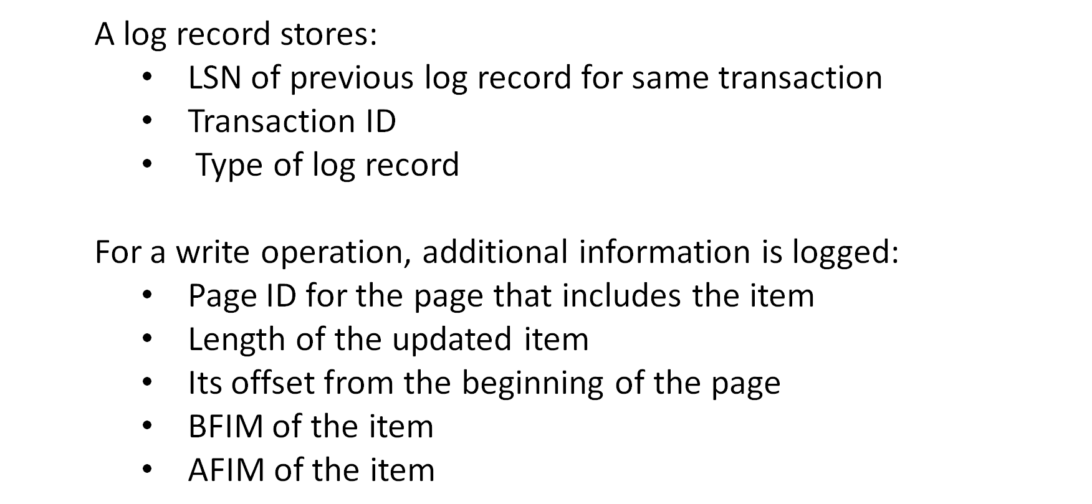
The Log and Log Sequence Number (LSN)
© 2016 KL University – The contents of this presentation are an intellectual and copyrighted property of KL University. ALL RIGHTS RESERVED

Slide 6
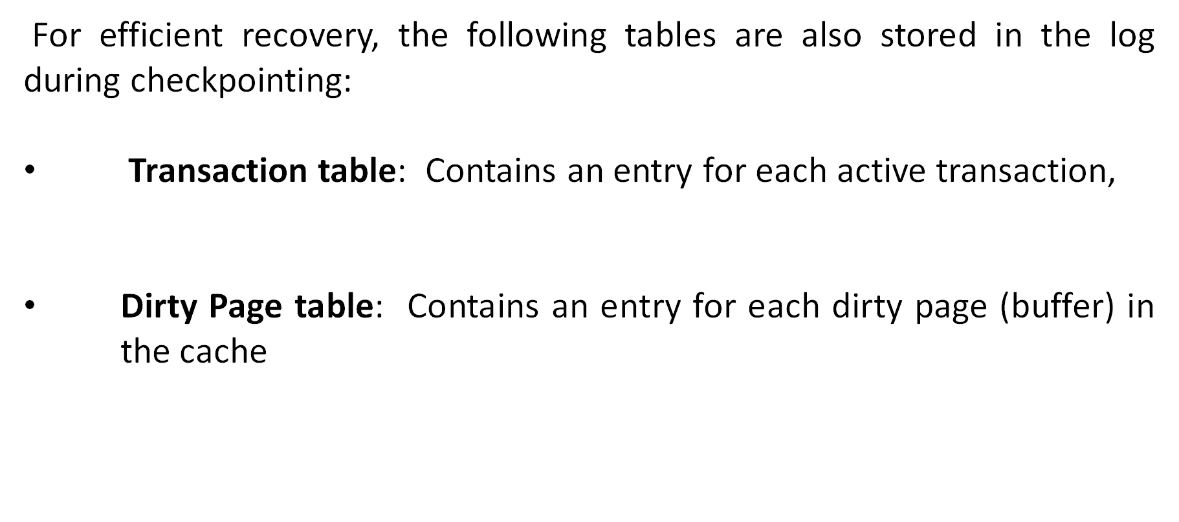
  The Transaction table and the Dirty Page table
© 2016 KL University – The contents of this presentation are an intellectual and copyrighted property of KL University. ALL RIGHTS RESERVED

Slide 7
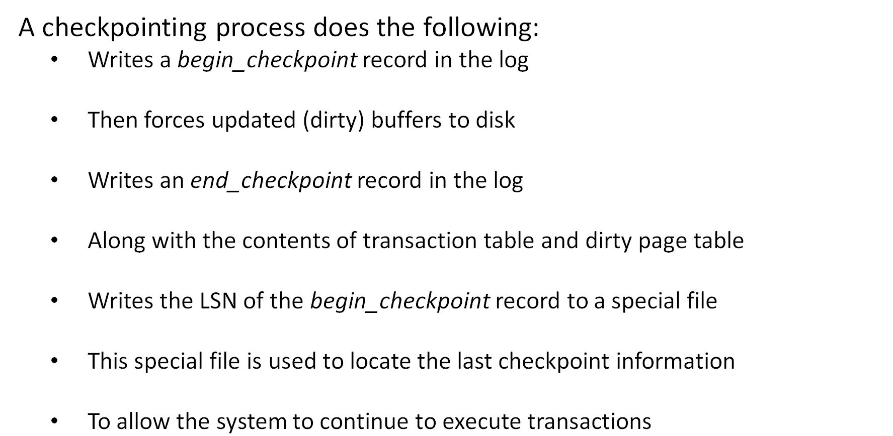
  Fuzzy Checkpointing
© 2016 KL University – The contents of this presentation are an intellectual and copyrighted property of KL University. ALL RIGHTS RESERVED

Slide 8
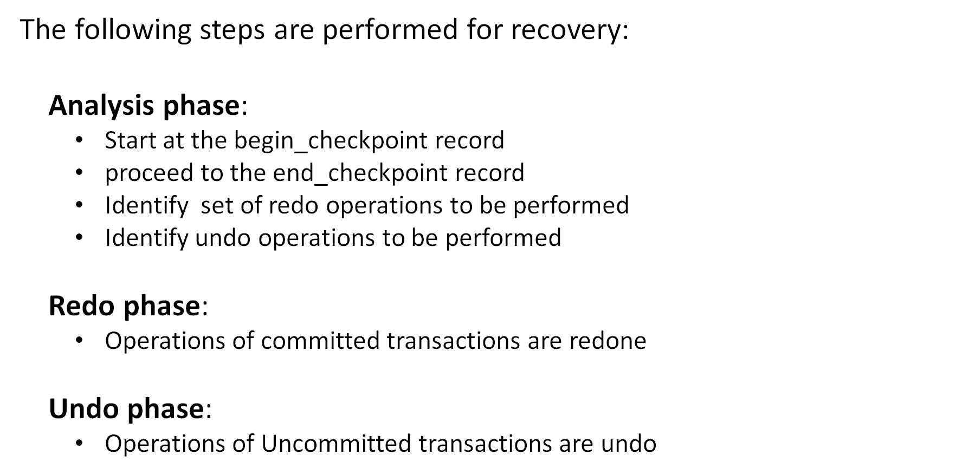
  Recovery
© 2016 KL University – The contents of this presentation are an intellectual and copyrighted property of KL University. ALL RIGHTS RESERVED

Slide 9
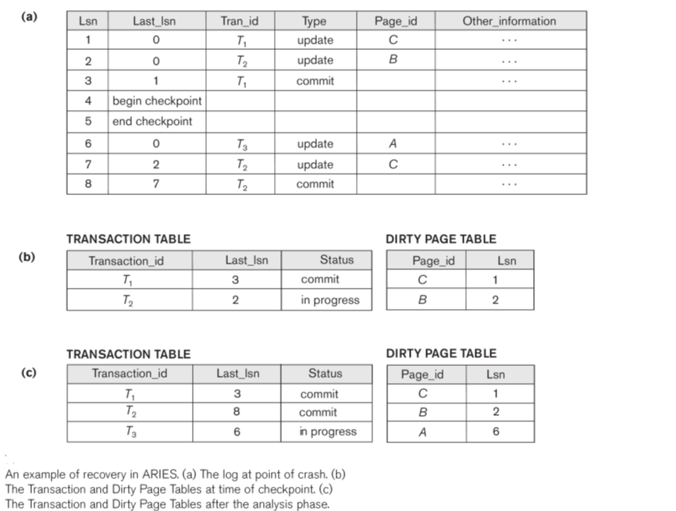

  Example
© 2016 KL University – The contents of this presentation are an intellectual and copyrighted property of KL University. ALL RIGHTS RESERVED

